Slide 1
IMAGE Classification Using a Neural Net - Tensorflow
Viraat Das
Purdue Workshop

Slide 2
WUSSSSSUUUUUPPPPP
https://colab.research.google.com
https://github.com/viraatdas/Neural-Network-Purdue-Workshop

Slide 3
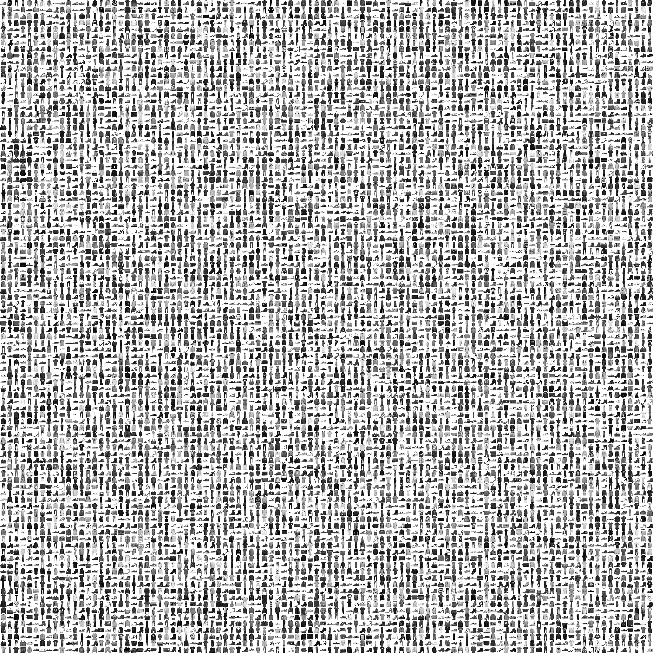
MNIST Fashion Dataset
60,000 images to train the neural net
10,000 images to evaluate the accuracy

Slide 4
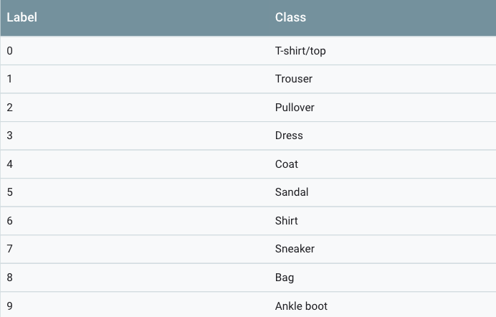
Labels

Slide 5
WHAT EXACTLY ARE WE TRAINING?
Each image is 28 x 28 pixels stored as a numpy array
60,000 of these images are being used to train
Later to test the accuracy of the model, we will use 10,000 test images

Slide 6
Structure

Slide 7
Activation Functions
ReLU – Rectified Linear Unit
Used to introduce non-linearity in a model
We are using one hidden layer with 128 neurons, each rectified
Softmax Function
In our case returns an array of 10 probability scores that sum to 1

Slide 8
Model Compile
Loss Function – model’s accuracy while training. Should be minimized.
Optimizer – Based on loss function, updates the model
Metrics - Used to monitor training and testing steps. Used in tensorboard.

Slide 9
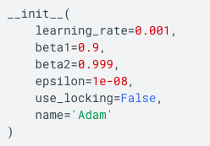
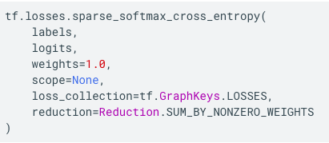
Model Compile Properties
Optimizer – based on
Adam’s Algorithm
Loss Function – Sparse Softmax Cross Entropy
Metrics – Accuracy
Calculates how often predictions matches labels
Notes:
https://www.tensorflow.org/api_docs/python/tf/train/AdamOptimizer
https://www.tensorflow.org/api_docs/python/tf/losses/sparse_softmax_cross_entropy

Slide 10
What is one Epoch?

